Slide 1
FAMILY &FRIENDS 1
National Edition

Slide 2
UNIT 5 : THIS IS MY NOSE!
LESSON 2 : GRAMMAR and SONG

Slide 3
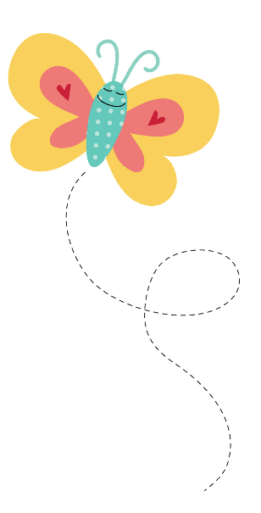
WARM UP

Slide 4
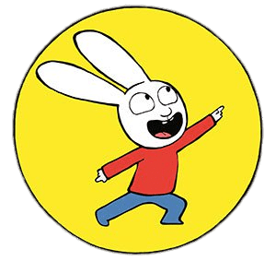
SIMON
SAYS
Notes:
- Ask the students to stand at their desks.
- Explain the rules: If the instruction begins with the words Simon says, students must do as you say. If not, they should stand still and wait for the next instruction. Any student who gets this wrong is out of the game and has to sit down.
EX: Simon says point to your nose; Simon says point to your legs; Simon says wave your arms; touch your nose;…
- Continue the game until there is one winner left standing, or a group of winners if you prefer.

Slide 5
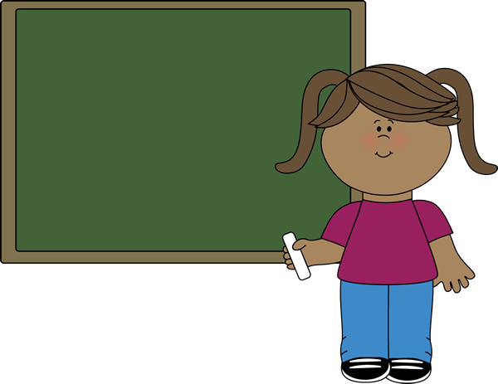
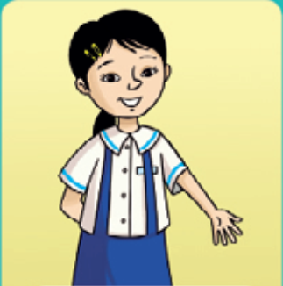
one arm
Notes:
- Hold up one arm and say one arm.
- Hold up two arms and elicit two arms.
- Repeat with your fingers and legs, eliciting the answers from the children and emphasizing the plural –s.
- Raise one arm and say: This is one arm.
- Raise 2 arms and say: These are arms.
Listen and repeat, track 63
- Play track 63, listen and point
- Play again, ask students to listen and point
- Play again, ask students to listen and repeat

Slide 6
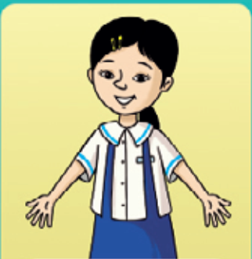
two arms

Slide 7
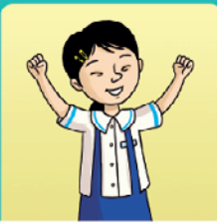
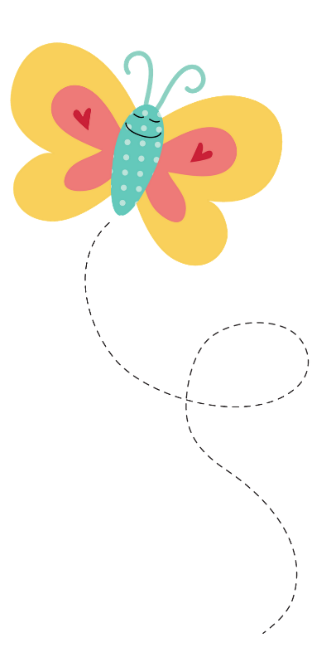
These are my arms.

Slide 8
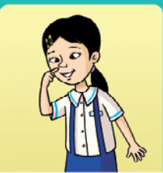
This is my nose.

Slide 9
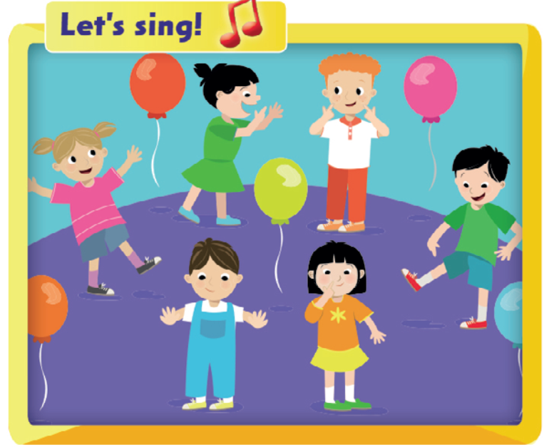
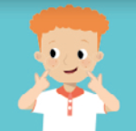
Notes:
- Point to the pictures and elicit the parts of the body.

Slide 10
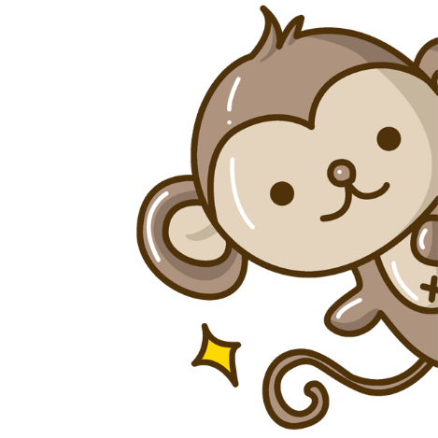
Who’s faster ?

Slide 11
Notes:
- Play the song.
- Students listen and points to the six new words
- Play the recording again and students listen and sing along.
- Students practice several times singing and pointing to their body parts.
Below level: Students stand up and do the actions (e.g. point to the relevant body part) along with the music and join in with the singing when they are ready.
At level: Pause the song at the end of each line, so that the children have to finish the line themselves.
Above level: Children can practice the ‘At level’ activity first.
- Then write the words of the song on the board with blanks for the body parts.
- Elicit the missing words from the children and complete the song on the board with the audio.
- Listen and sing again.

Slide 12
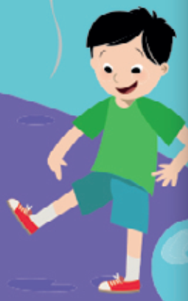
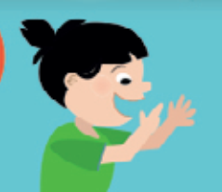
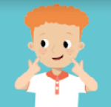
Let’s talk !
Notes:
- Ask students to look at the picture and the words in the speech bubble. - Hold up your arms and say These are my arms.
- Have a student demonstrate the sentence in the speech bubble again.
- Students work in pairs to take turns saying the sentence and making new sentences.

Slide 13
